Slide 1
FitBit Fitness Tracker analysis
Insights for Bellabeat

Slide 2
Data set
Source: FitBit Fitness Tracker Data
Link: https://www.kaggle.com/datasets/arashnic/fitbit?resource=download-directory
Content: 30 eligible Fitbit users, surveyed for their app usage.

Slide 3
Tables used
daily_activity: daily activity of users
hourly_calories: calories burned per hour
hourly_intensity: activity intensity per hour
hourly_steps: total steps per hour

Slide 4
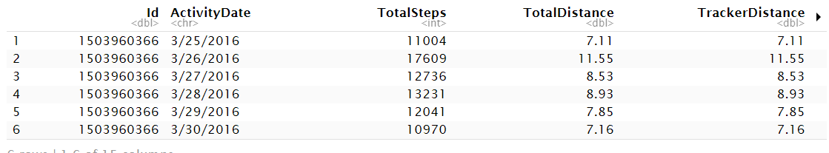
Example of tables
Activity table

Slide 5
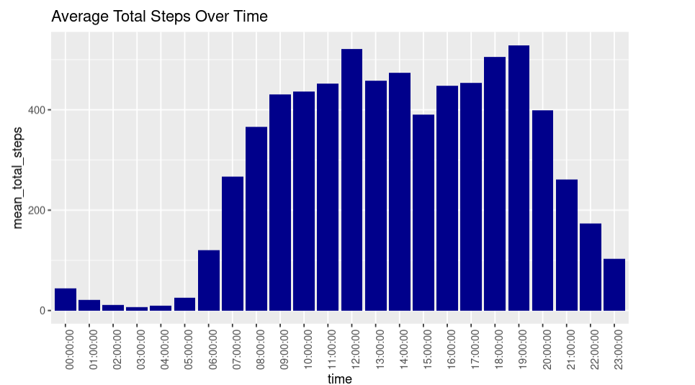
Hourly Steps and Intensity Over Time

Slide 6
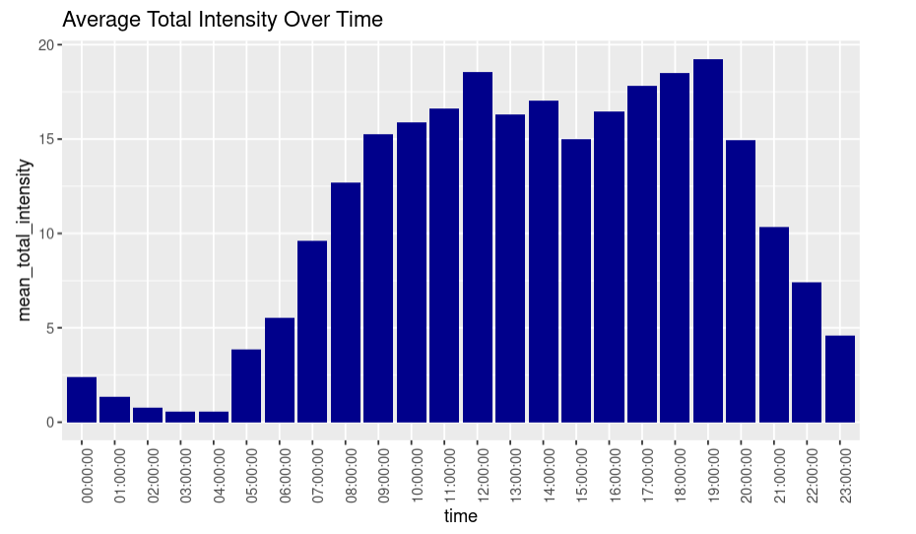

Slide 7
Hourly steps and intensity data show strong correlation
Higher step count associated with higher intensity activities
Peak in steps and intensity consistently occurs between 5-7pm
Opportunity for further investigation into factors driving activity during this time
Insights could inform lifestyle decisions and support optimal health
Two main peaks in hourly steps: 12pm and 6pm
Lunchtime: walking to restaurant, post-lunch exercise
Evening: walking home or to gym, increased intensity observed

Slide 8
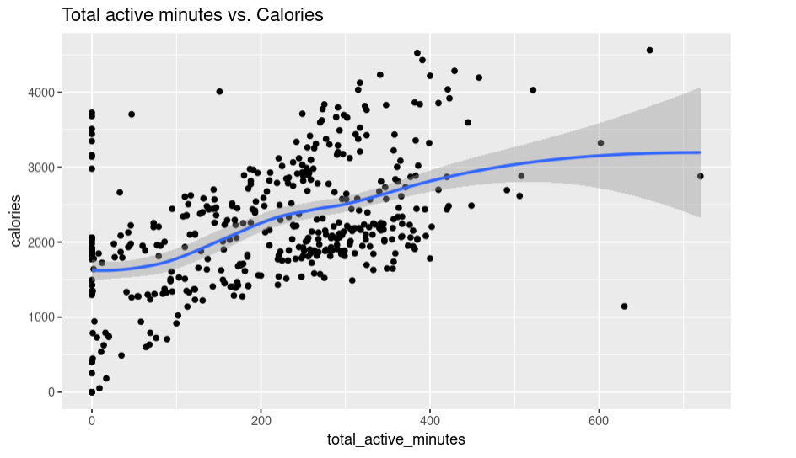

Slide 9
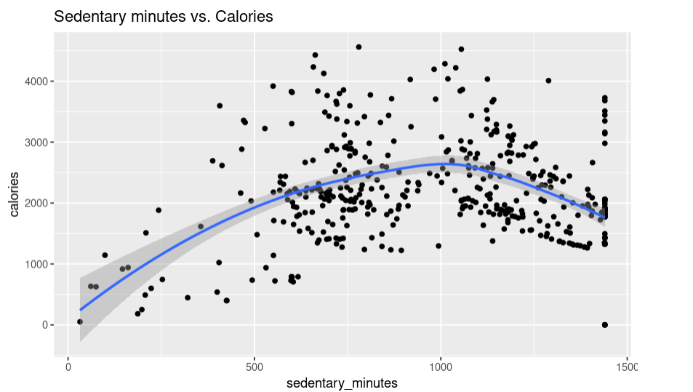

Slide 10
Active minutes positively correlate with calories burned
More active minutes lead to higher energy expenditure

Slide 11
Insights
Tailor app content to typical daily habits of adults
Leverage data showing increased activity after lunch and work
Provide workout programs that fit users' lifestyles
Introduce guided evening workout routines through Bellabeat app
Quick and effective exercises for busy schedules

Slide 12
Insights
Implement motivational features
Set personalized activity goals based on fitness levels
Provide rewards or incentives for reaching milestones
Integrate social sharing for competition and achievement sharing
Utilize data analytics and innovative features to position Bellabeat as a market leader
Offer personalized solutions for activity tracking, sleep improvement, and calorie optimization
Continuously innovate and expand product offerings
Help users achieve health and wellness goals for happier, healthier lives

Slide 13
Thank you for your attention

